Slide 1
Chapter 9
Language Development
Notes:
Add slide notes here

Slide 2
Foundations of Language (1 of 2)
Language is a complex system of associations between sounds and meaning.
Phonology: rules for combining basic units of sound (phenomes).
Morphology: rules for combining the smallest units meaning of a language (morphemes) into words.
Notes:
LO 9-1: Identify the five components of language.
I. Foundations of Language
A. Language is a complex system of associations between sounds and meaning
B. Made of five basic components:
a. Phonology: the basic units of sounds (known as phenomes) used in a given language and the rules for combining them
b. Morphology: the rules for combining morphemes (the smallest unit of language that has meaning) into words

Slide 3
Foundations of Language (2 of 2)
Syntax: rules for combining words into sentences.
Semantics: meaning/content of words and sentences.
Pragmatics: understanding how to use language to communicate effectively.
Notes:
LO 9-1: Identify the five components of language.
c. Syntax: the rules for combining words to form sentences, including which combinations are correct and which are not
d. Semantics: the meaning or content of words and sentences
e. Pragmatics: understanding how to use language to communicate effectively

Slide 4
Basic Components (1 of 2)
Phonemes
  Basic units of sound that can change the meaning of a word
  Languages also specify how phonemes can be combined
Morphemes
  Basic units of meaning that exist in a word

Slide 5
Basic Components (2 of 2)
Prosody
  How the sounds are produced
  Melody of speech because it includes pitch or intonation
Left hemisphere of brain shows activity when listening to speech
Right hemisphere shows activity when processing speech

Slide 6
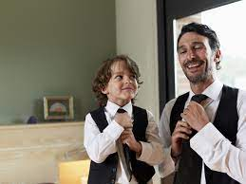

How does Language Development?
Simplest theory is imitation
  Problems with this?
  Children make grammatical mistakes that adults don’t
  Imitation is important for accent development

Slide 7
Theories: Nature & Nurture (1 of 4)
Universal grammar
  System of common rules and properties for learning any of the world’s languages
Language acquisition device
  Areas of the brain that:
    Sift through language
    Apply the universal rules
    Begin tailoring the system to the specifics of the language spoken in the young child’s environment
Notes:
Everything is in born

Slide 8
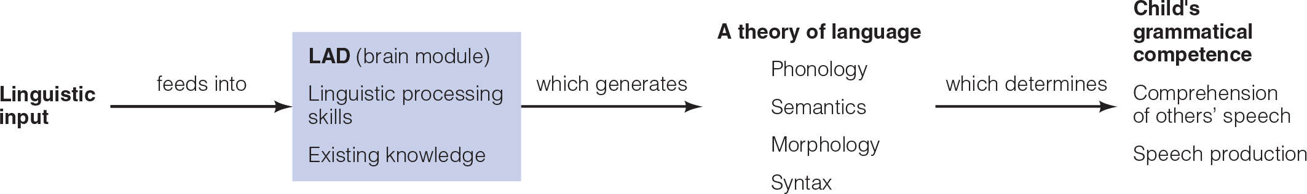
The Language Acquisition Device (LAD)
Notes:
Figure 10.2 The language acquisition device (LAD)

Slide 9
Theories: Nature & Nurture (2 of 4)
Nativist perspective
  Poverty of the stimulus
    Environmental stimulus of language input is too impoverished to support the linguistic output that we see emerge
  Young children learn native language with ease but struggle later to learn second language
  Capacity for acquiring language has a genetic basis
Notes:
Way more language output than input!

Slide 10
Theories: Nature & Nurture (3 of 4)
How does the environment influence language development?
  Children learn the words they hear spoken by others
  More likely to start using new words if they are reinforced

Slide 11
Theories: Nature & Nurture (4 of 4)
Interactionist perspective
  Children’s biologically-based competencies and language environment interact to shape course of language development
  Similar view as Piaget, Vygotsky
  Differences in perspectives

Slide 12
How do Infants Acquire Speech?
Babies are “hardwired” for speech
  The left hemisphere of a newborn’s brain is sensitive to language
Babies prefer to listen to speech over complex non-speech sounds
Babies can distinguish consonant sounds as well as vowel sounds

Slide 13
The Critical Period (1)
Critical period == time when the brain is particularly primed to receive input and learn language
What happens if brain is primed for language but never gets any input?
  Answering this question would shed some light on whether the critical period exists

Slide 14
The Critical Period (2)
How to test?
  Could raise a child in a vacuum without language input
  Highly unethical (forbidden experiment)
Observe situations where it might happen
  “Feral Children”
    “Raised by wolves” – usually myth/legend
  Child abuse cases

Slide 15
Case Study: Genie Wiley (1 of 4)
In 1970 was admitted to a children’s hospital in Los Angeles at the age of 13
Spent the majority of her life (from the age of 2 onwards) strapped to a potty chair and locked away in a closet
The only human contact she had was with her mother

Slide 16


Case Study: Genie Wiley (2 of 4)
A few things to note:
  Mother was forbidden to spend more than a few minutes at a time with her
  No TV or Radio in the home
  No members of the family spoke to her
Genie grew up in a state of total physical, sensory, social, and emotional deprivation

Slide 17
Case Study: Genie Wiley (3 of 4)
Genie was not exposed to language during the critical period
Genie was eventually able to learn some language
  Struggled with morphology and syntax
  Struggled with grammar rules
Neurological tests showed no left-hemisphere language activity!

Slide 18
Case Study: Genie Wiley (4 of 4)
How was she able to use language?
  Plasticity!
  Right hemisphere attempted to compensate for the deficient language areas in the left hemisphere
As Genie began to acquire language, she went through some of the same stages normal children go through

Slide 19
Language Development in Infancy and Toddlerhood (1 of 11)
Early Preferences for Speech Sounds
  Newborns show preferences for speech sounds, especially those in their native language.
  Social input influences the timing of infants’ speech sound discrimination.
  Native-language discrimination ability at 6–7 months predicts the rate of language growth between 11–30 months.
Notes:
LO 9-2: Summarize patterns of language development during infancy and toddlerhood.
II. Language Development in Infancy and Toddlerhood
A. Early Preferences for Speech Sounds
a. Newborns show preferences for speech sounds over other sounds, especially those made in their native language
b. Infants can discriminate their names at 4½ months, evidenced by turning their heads when they hear it
c. Sound discrimination is influenced and conditioned by context, as infants are better able to recognize and show preferences for sounds they hear more often
d. Social input plays a critical role in the timing of infants’ narrowing of speech sound discrimination, especially with caregivers
e. Native-language discrimination ability between 6-7 months predicts the rate of language growth between 11-30 months

Slide 20
Language Development in Infancy and Toddlerhood (2 of 11)
Prelinguistic Communication
  Crying
  Cooing: making deliberate vowel sounds, such as “ahhhh,” that begins around 2–3 months.
  Babbling: repeating strings of consonants and vowels, such as “ma-ma-ma,” that begins around 6 months.
  Language acquisition is socially interactive.
Notes:
LO 9-2: Summarize patterns of language development during infancy and toddlerhood.
B. Prelinguistic Communication
a. At birth, infants cry
b. Cooing: making deliberate vowel sounds, such as “ahhhh,” “ohhhh,” and “eeeee,” that begins around 2-3 months
c. Babbling: repeating strings of consonants and vowels, such as “ba-ba-ba” and “ma-ma-ma,” that begins to appear at about 6 months
d. Language acquisition is a socially interactive process—babies learn by hearing others speak and by the reactions their vocalizations evoke in caregivers

Slide 21
Language Development in Infancy and Toddlerhood (3 of 11)
12 months
  Infants begin to use social and linguistic cues to learn words
  Joint attention
    Two people looking at the same thing
  Syntactic bootstrapping
    Where a word is placed in a sentence—to determine the meaning of the word

Slide 22
Language Development in Infancy and Toddlerhood (4 of 11)
Putting Words Together: First Words
  Receptive language: what babies can understand.
  Productive language: what babies can produce themselves.
Holophrases
  Single word often conveys an entire sentence’s worth of meaning
  Infant’s first word spoken around one year of age
  First 50 words consist of common nouns representing objects and people
What kind of early words do babies usually use?

Slide 23
Example Words
Category | Words
Sound effects | baa baa, meow, moo, ouch, uh-oh, woof, yum-yum
Food and drink | apple, banana, cookie, cheese, cracker, juice, milk, water
Animals | bear, bird, bunny, dog, cat, cow, duck, fish, kitty, horse, pig, puppy
Body parts and clothing | diaper, ear, eye, foot, hair, hand, hat, mouth, nose, toe, tooth, shoe
House and outdoors | blanket, chair, cup, door, flower, keys, outside, spoon, tree, TV
People | baby, daddy, gramma, grampa, mommy, [child’s own name]
Toys and vehicles | ball, balloon, bike, boat, book, bubbles, plane, truck, toy
Actions | down, eat, go, sit, up
Games and routines | bath, bye, hi, night-night, no, peek-aboo, please, shhh, thank you, yes
Adjectives and descriptors | all gone, cold, dirty, hot

Slide 24
Language Development in Infancy and Toddlerhood (5 of 11)
18 months
  Vocabulary spurt
    Pace of word learning quickens dramatically
  At 20 months, children produce average of 150 words
  24 months, 300 words
    Fast mapping: allows children to determine the object of a word and then remember this for future encounters with the word

Slide 25
Language Development in Infancy and Toddlerhood (6 of 11)
Putting Words Together
  Fast mapping: quickly acquiring and retaining a word after hearing it applied a few times.
  Telegraphic speech: utterances of simple two-word sentences that use a few precise words to express thought.
Notes:
LO 9-2: Summarize patterns of language development during infancy and toddlerhood.
b. Learning Words
i. Fast mapping: a process of quickly acquiring and retaining a word after hearing it applied a few times that begins by 13 months of age
ii. Vocabulary spurt: a period of rapid vocabulary learning that occurs between 16 and 24 months of age
iii. Underextension: applying a word more narrowly than it is usually applied so that the word’s use is restricted to a single object
Overextension: applying a word too broadly

Slide 26
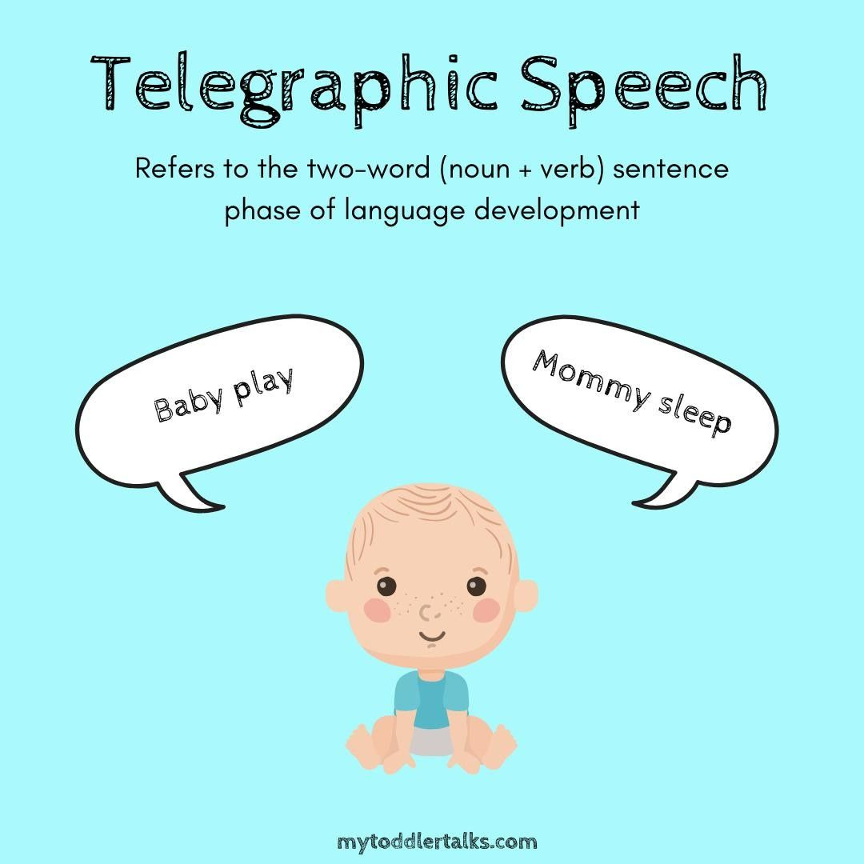

Slide 27
Language Development in Infancy and Toddlerhood (7 of 11)
Infant Gesture
  Early research suggested babies acquire symbolic gestures when trained to use baby signing
  Later research suggests language development is similar for all babies.
  If baby signing promotes frequent parent–infant interaction, does not rush/pressure infants, and is helpful in parents’ estimation, there is no reason to discourage it.
Notes:
LO 9-2: Summarize patterns of language development during infancy and toddlerhood.
D. Infant Gesture
a. Baby-Signing Debate
i. Early research suggested babies acquire symbolic gestures when trained to use baby signing and manufacturers developed baby signing products
ii. Comparison of 33 websites selling baby signing products found all advertised benefits such as faster language development, and many claimed to foster cognitive and emotional development, improved parent-child relationships, and fewer tantrums and behavior problems
iii. Research studies examining the outcomes of baby signing programs found that although some of the studies suggested some benefits, nearly all contained methodological weaknesses
iv. A longitudinal study found at 20 months, the language development was similar for all babies, regardless of intervention
b. Caregiver-Infant Interaction
i. Baby signing programs lack scientific support, but many report that baby signing has improved children’s ability to communicate, cognitive ability, and overall caregiver–infant interactions
ii. Rich infant-caregiver interactions promote cognitive, language, and social development
iii. If baby signing promotes frequent parent–infant interaction, does not rush or pressure infants, and is helpful in parents’ estimation, there is no reason to discourage it

Slide 28
Language Development in Infancy and Toddlerhood (8 of 11)
Language Development in Bilingual Infants
  Across both languages, bilingual children’s vocabulary tends to be equal or bigger.
  Some research suggests bilingual infants are better at learning new words.
Language Development in Deaf Infants
  Screening and intervention promote access to visual and/or spoken language.
  Engaging infant-directed speech, gestures, and touching can support infants’ development.
Notes:
LO 9-2: Summarize patterns of language development during infancy and toddlerhood.
E. Language Development in Bilingual Infants
a. Bilingual infants to retain the ability to discriminate phonetic speech sounds of other languages long after monolingual peers have narrowed their perception
b. Language growth, whether with one or multiple, is related to the quality and quantity of infant-directed speech
c. Combined across both languages, bilingual children’s vocabulary tends to be equal or greater than monolingual children
d. Some research suggests that bilingual infants are better at learning new words than their monolingual peers because of exposure to sounds of multiple languages
F. Language Development in Deaf Infants
a. ~2 in 1,000 U.S. infants born with profound hearing loss
b. Universal neonatal hearing screening and early intervention promoting access to visual and/or spoken language
c. Hearing aids and/or cochlear implants
d. Early hearing loss disrupts social interactions with caregivers and affects the development of cognitive skills, such as memory, attention, learning, and information processing (language learning)
e. Outcomes are influenced by contextual factors
f. Children with hearing loss may be especially sensitive to variations in language environmental quality
g. Engaging and responsive infant-directed speech, gestures, and touching can help infants interact with the world and support their development

Slide 29
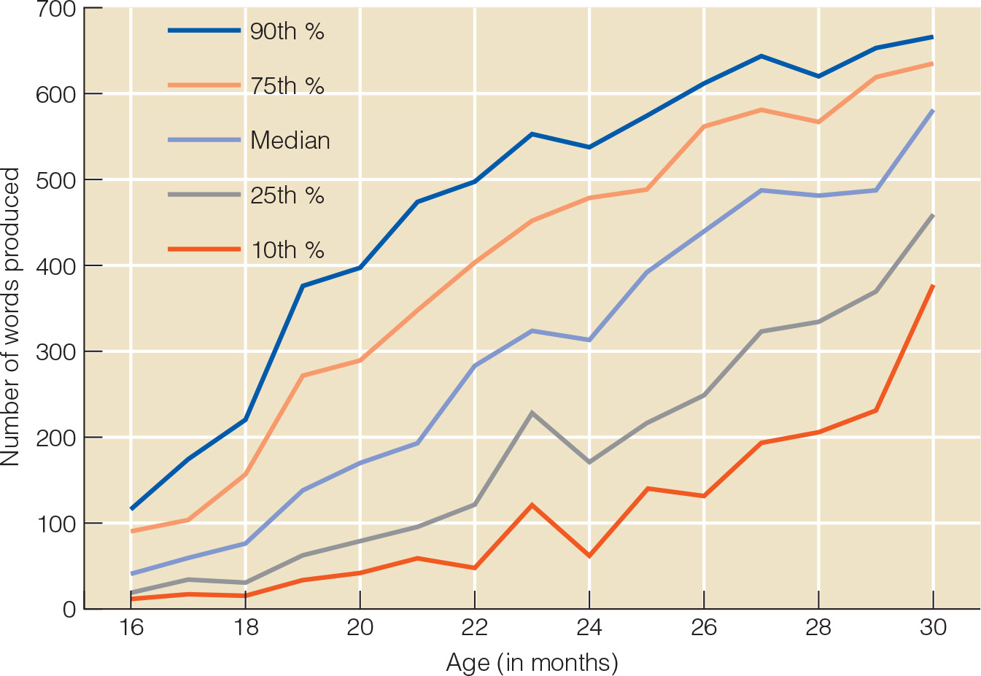
Notes:
Figure 10.3

Slide 30
Language Development in Infancy and Toddlerhood (9 of 11)
Children make mistakes in language
  Overextension
    A child uses the word doggie to refer to all four-legged animals
  Underextension
    A child uses the word doggie to refer only to basset hounds like the family pet

Slide 31
Common Overextensions
Object Name | Child’s Use
Cat | Any small animal on four legs
scissors | Any sharp object
Fly | Any insect
Ball | Anything round, including rocks, apples, or grapes

Slide 32
Language Development in Infancy and Toddlerhood (10 of 11)
Children’s language progress reveals itself in mistakes
  Overregularization
    Overapplying the rules to cases in which the proper form is irregular
Transformational grammar
  Rules of syntax for transforming basic underlying thoughts into a variety of sentence forms

Slide 33
Language Development in Infancy and Toddlerhood (11 of 11)
Early Childhood: Vocabulary
  Children learn quicker in response to human speakers and within meaningful contexts.
  Logical extension: children, when learning a word, extend it to other objects in the same category.
  Mutual exclusivity assumption: at around 3, children assume objects have only one name, and a new word is assumed to be a label for an unfamiliar object.
Notes:
LO 9-3: Examine language development from early childhood through late adulthood.
III. Language Development over the Lifespan
A. Early Childhood
a. Vocabulary
i. Interactive Contexts
1. Words that children hear often, that label things and events that interest them, and that they encounter in meaningful contexts
2. Learn quicker in response to human speakers, especially when the speaker responds to them
3. Turn-taking, joint attention, and scaffolding experiences that provide hints to the meaning of new words
ii. Word-Learning Strategies
1. Logical extension: a strategy children use to increase their vocabulary in which children, when learning a word, extend it to other objects in the same category
2. Mutual exclusivity assumption: the phenomenon when, at around age 3, children assume that objects have only one label or name, and a new word is assumed to be a label for an unfamiliar object, not a synonym or second label for a familiar object
iii. Context-Based Learning
1. If a word is used in context or explained with examples, most 5-year-olds can learn it
2. Inferential learning is associated with better retention than learning by direct instruction
3. Young children have difficulty understanding that words that express comparisons are relative and used to compare objects
4. Children have difficulty with words that express relative place and time

Slide 34
Early Education (1 of 3)
Studies of babies watching educational videos
  For each hour spent watching videos, babies understood six to eight fewer words
Studies on educational preschool programs
  Initial advantage in basic academic skills
  Less creative, more anxious in testing situations, and more negative toward school than social oriented preschool

Slide 35
Early Education (2 of 3)
Preschool programs that offer a healthy mix of play and academic activities can be beneficial
  Abecedarian Project
    Children showed cognitive gains during and after
    Completed more years of education than those in the comparison group
    No differences between the two groups on criminal activity at age 30

Slide 36
Early Education (3 of 3)
Positive effects of early education are likely if it:
  Stimulates cognitive growth
  Provides programming for parents
  Includes follow-up in elementary school
  Full-day programs
  Allow time for play and social interaction

Slide 37
Discussion
What is the best way to teach a child to read? Why?

Slide 38
Expanding Language Skills & Learning to Read
Middle childhood brings increased metalinguistic awareness
  Knowledge of language as a system
  Children who are metalinguistic understand the concept of words and can define words
  Children can distinguish between grammatically correct and incorrect sentences
  Bilingual children have better metalinguistic skills

Slide 39
Learning to Read
Reading acquisition requires direct instruction
Children must understand alphabetic principle
  Idea that letters in printed words represent the sounds in spoken words in a systematic way
Deliberate → Automatic

Slide 40
Dyslexia
Dyslexia is characterized by:
  Difficulties with oral language
  Difficulties with written language
  Difficulties with reading

